Slide 1
Improving the Design of Conditional Transfer Programs: Evidence from a Randomized Education Experiment in Colombia
Felipe Barrera-Osorio, Marianne Bertrand, Leigh L. Linden and Francisco Perez-Calle
ECON 541 Lauren Coker

Slide 2
Motivation
To prevent students from dropping out of secondary schools and encourage matriculation at tertiary institutions
In 2005 the city of Bogota established the Conditional Subsidies for School Attendance program in an effort to increase student retention, lower drop-out rates, and reduce child labor
Secretary of Education of the City (SED) decided to implement a pilot study utilizing a conditional cash transfer model in 2 of the 12 localities in the city
Pilot was run for a year and then the results would be used to inform the design of the final program

Slide 3
Background
Average attendance rate declines with age and drops faster for low income individuals
For individuals falling into the bottom two categories of the Colombian poverty index, attendance rate for 15 year-old is 84%, 16 year-old is 80%, and 17 year-old is 65%
In 2003 there were 89,000 children between 5-18 years old who were out of school with 70% of those classified in the bottom two categories of the Colombian poverty index
When surveyed, students claim that the major reason for dropping out is the cost of education
CCT (Conditional cash transfer) programs have become a popular and effective mechanism for incentivizing academic participation
Most programs are inspired by the Mexican Conditional Cash Transfer program known as Oportunidades
Under this program, students are paid on a monthly or bi-monthly basis for meeting a specified attendance (usually 80% per month) target.

Slide 4
Experiment Design
Used a student level randomization, compared three education-based conditional cash transfers designs:
1) A standard design (Basic Treatment)
Participants receive $15 per month as long as the child attended at least 80% of the days that month. Payments were made bi-monthly.
2) A design where part of the monthly transfers are postponed until children have to re-enroll in school (Savings Treatment)
Varied the timing of the distributions to students’ families. Students were paid 2/3 of the basic treatment ($10) amount on a bi-monthly basis, while the remaining one-third was held in a bank account
The accumulated funds were then made available to student’s families during the period in which students prepare to enroll for the next school year
3) A design that lowers the reward for attendance but incentivizes graduation and tertiary enrollment (Tertiary Treatment)
In the short term, the monthly transfer for good attendance is $10. However, upon graduating the student earns the right to receive a transfer of $300 which 73% of the average cost of the first year at a vocational school.

Slide 5
Experiment Design (cont.)
Applied the treatments to two similar localities in Bogota: San Cristobal and Suba
Eligible registrants in San Cristobal, ranging from grade 6-11, were randomly assigned between a control group, the basic treatment, and the savings treatment
Tertiary treatment was evaluated separately in an experiment in Suba, where students ranging from grade nine through eleven, were randomly assigned to either the tertiary treatment or control group
Eligible registrants had to meet the following requirements:
1) Completed grade 5 for basic and savings experiment
2) Completed grade 8 for tertiary experiment
3) For both treatments, had to be enrolled but not yet graduated from grade 11
4) Children’s families had to have been classified into the bottom two categories on Colombia’s poverty index, SISBEN

Slide 6
Data
Data came from six sources
SISBEN- Regarding eligibility and family level characteristics
Registration Data- Birthdate, gender, last grade completed
Administrative records from the SED- Administrative records of every child in public school and most private schools
Collected baseline data and subsequent attendance data in 68 schools with the largest number of registered children
Collected attendance data during the last quarter of 2005 through direct observation
Conducted both a baseline and follow-up survey on students in the 68 schools
Baseline conducted in Feb-March 2005
Follow-up conducted Fed-Mach 2006

Slide 7
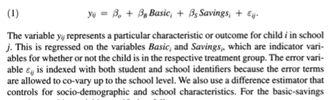
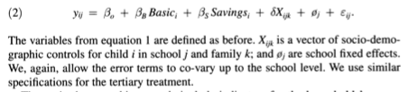
Models
Use a simple difference model that makes comparisons between different subsets of the sample
For the basic savings experiments:
Also use a difference estimator that controls for socio-demographic and school characteristics:

Slide 8
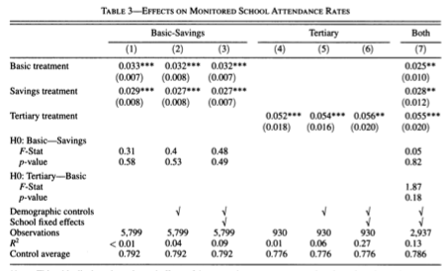
Results: Attendance
Column 1
Basic treatment increases attendance by 3.3%
Savings treatment increases attendance by 2.9%
Conclusion is that there is no evidence that the savings treatment is less effective than the basic treatment at boosting attendance, despite the lower monthly payments
Column 2 and 3
Estimate the same treatment effects by adding first socio-demographic controls and then school effects
Columns 4-6
Reports the equivalent estimates for the tertiary experiments
In each specification the estimates treatment effect is an increase in enrollment of a little more than 5%
Column 7
Direct comparison of the three programs with both demographic controls and school fixed-effects on a sample that includes all Suba students and subset of San Cristobal students that are in grades 9-11.

Slide 9
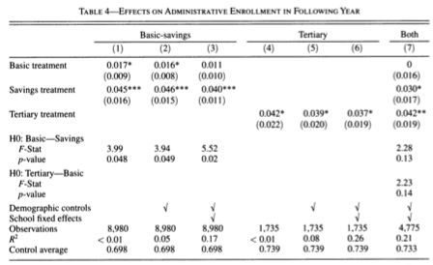
Results: Re-Enrollment
Savings treatment significantly increases enrollment by 4%
Basic treatment increases enrollment by only 1.1-1.17% depending on the specification
Tertiary treatment increases enrollment by 3.7%

Slide 10
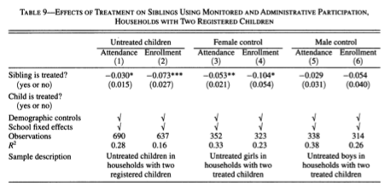
Results: Sibling Effect
Idea: Having a child enrolled in a CCT program may affect outcomes for his or her siblings
Columns 1 and 2
Compare untreated children with and without treated siblings using the monitored attendance and administrative enrollment data
Find on average untreated children with treated siblings have lower participation rates than untreated children whose siblings are also untreated
Attendance is lower by 3% and enrollment is 7.3% lower
Columns 3-6
Compare untreated children by gender
Find that the magnitude is stronger and only statistically significant at conventional levels for girls

Slide 11
Conclusion
Savings treatment increases enrollment in both secondary and tertiary institutions without reducing daily attendance
Incentivizing on graduation rather than just attendance leads to higher levels of daily attendance and higher levels of enrollment at the secondary and tertiary levels.
However, eligibility rules that cut across children rather than just across families may have unintended consequences
Critique
Are there other alternatives for limiting the sibling effect?
Limited budget in developing countries may be a problem if eligibility is across families rather than children
Additional room for research regarding parent’s preferences for enrolling children in the program (gender vs. age vs. work)
Parents had the opportunity to enroll all eligible children in their household. However, they found that not all eligible children were enrolled. Based on their analysis the other child suffers as a result

